Slide 1

WAY TO ENTERPRISE
AWS
VTI ACADEMY
Author: duy.nguyenngoc1@vti.com.vn

Slide 2
Scalability
Scalability
means that an application / system can handle greater loads
2 types
Vertical Scalability
Horizontal Scalability

Slide 3

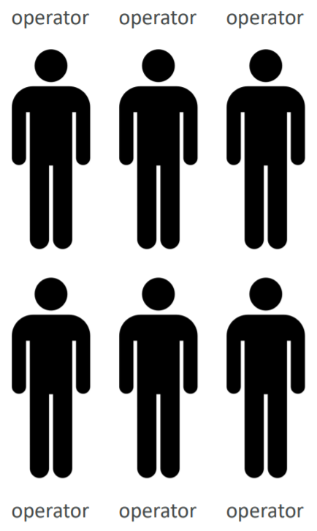
Scalability
Vertical Scalability (Next lesson)
means increasing/decreasing the size of the instance
hardware limit
Usecases: non distributed systems
Ex: RDS, ElastiCache, ….
Vertical Scalability
Horizontal Scalability (This lesson)
means increasing/decreasing the number of instances / systems for your application
Usecases: distributed systems
Ex: web applications / modern applications, ….
Horizontal Scalability

Slide 4
Scalability
Scalability for EC2
Vertical Scaling: Increase/decrease instance size (= scale up/down)
From: t2.nano - 0.5G of RAM, 1 vCPU
To: u-12tb1.metal – 12.3 TB of RAM, 448 vCPUs
Horizontal Scaling: Increase/decrease number of instances (= scale out/in)
Auto Scaling Group & Load Balancer

Slide 5
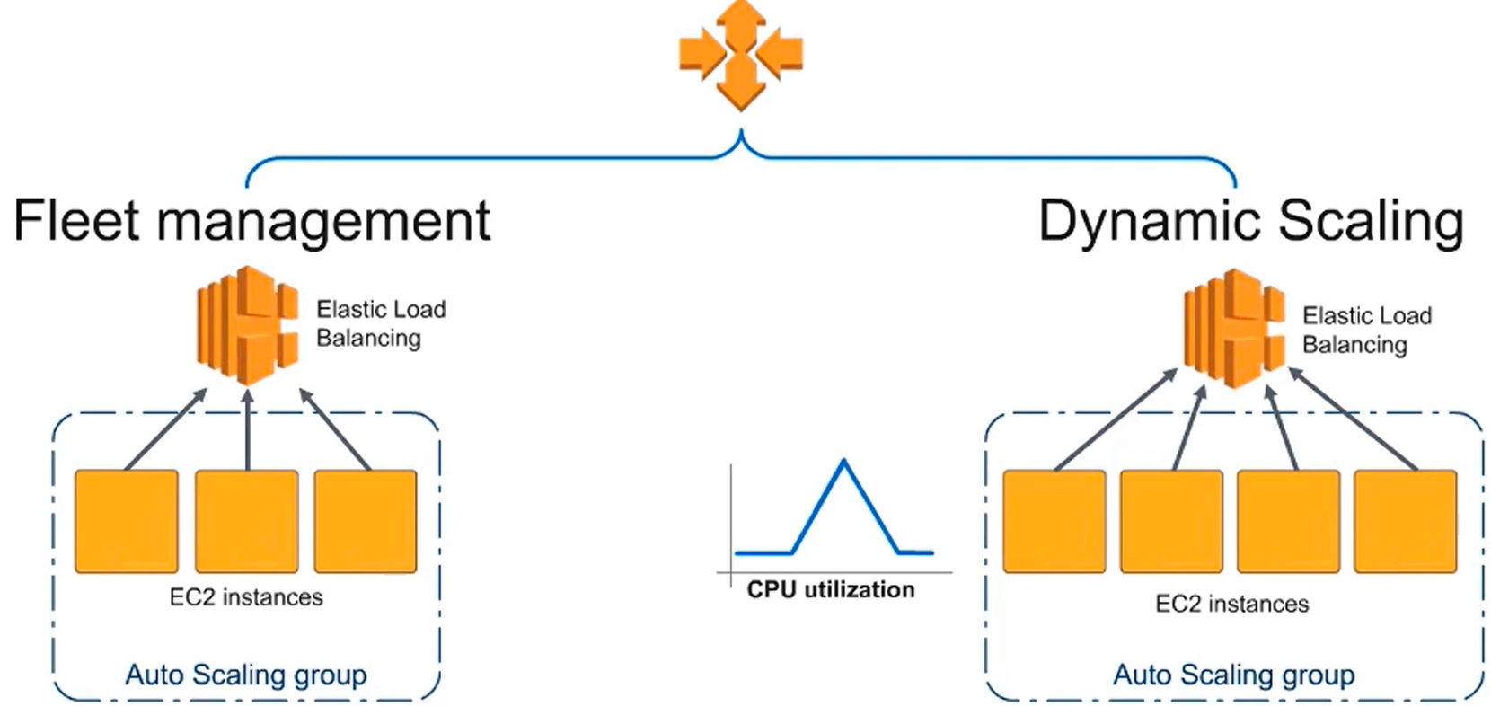
Auto Scaling Group Service
ASG make sure the available EC2 is working
You can config the instance to automatically turn on/off the instance when overloaded
Price: free, pay for the underlying resources being launched
Tutorial: https://docs.aws.amazon.com/autoscaling/ec2/userguide/what-is-amazon-ec2-auto-scaling.html

Slide 6
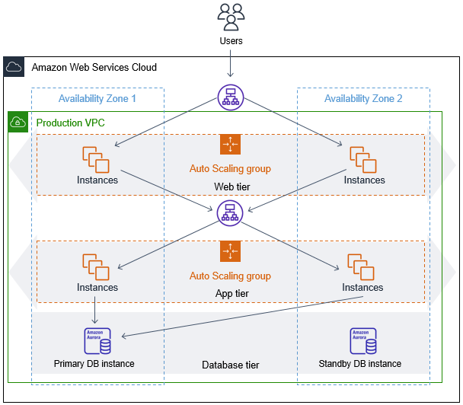
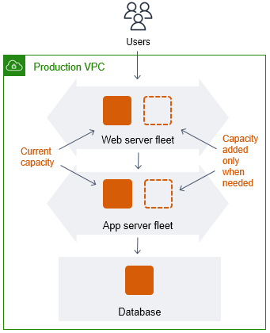
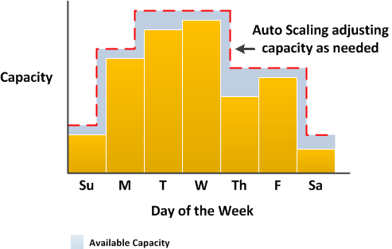
Auto Scaling Group Service
Usecases
The application has unstable traffic Ex: the sale event
Web Application
(capacity rebalancing)
Using both spot instance + on-demand instance for reducing cost
Distributed Application

Slide 7
Auto Scaling Group Service
Demo
Create Security Group
Create Launch Template
Create Auto Scaling Group
Manual scaling
Dynamic scaling
Attach Elastic Load Balancer

Slide 8
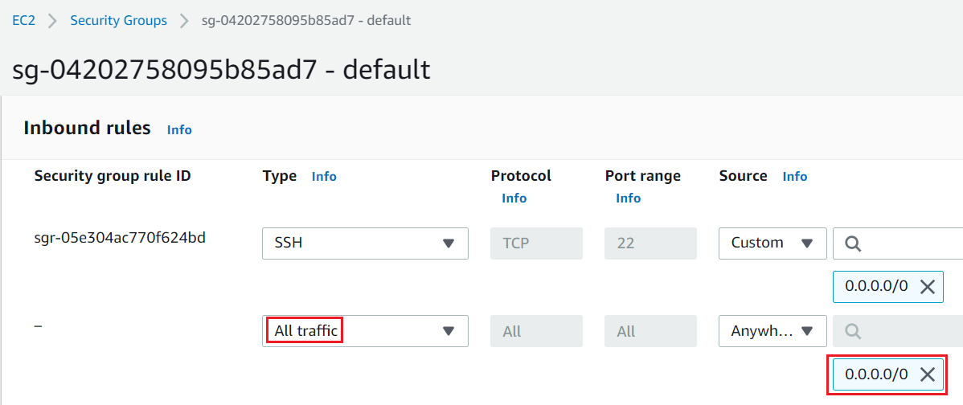
Auto Scaling Group Service
Create Security Group
Allow all traffic

Slide 9
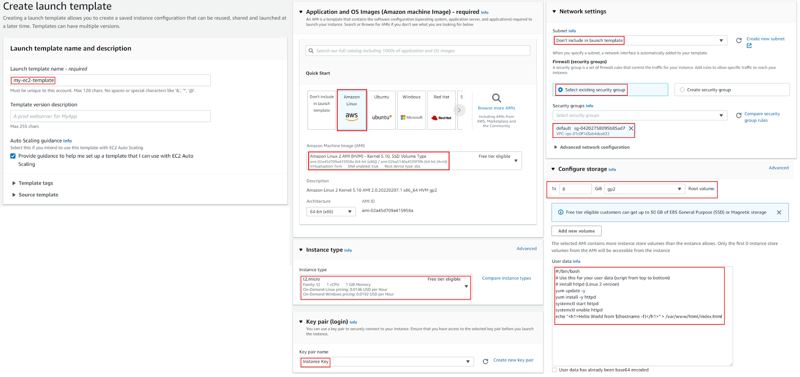
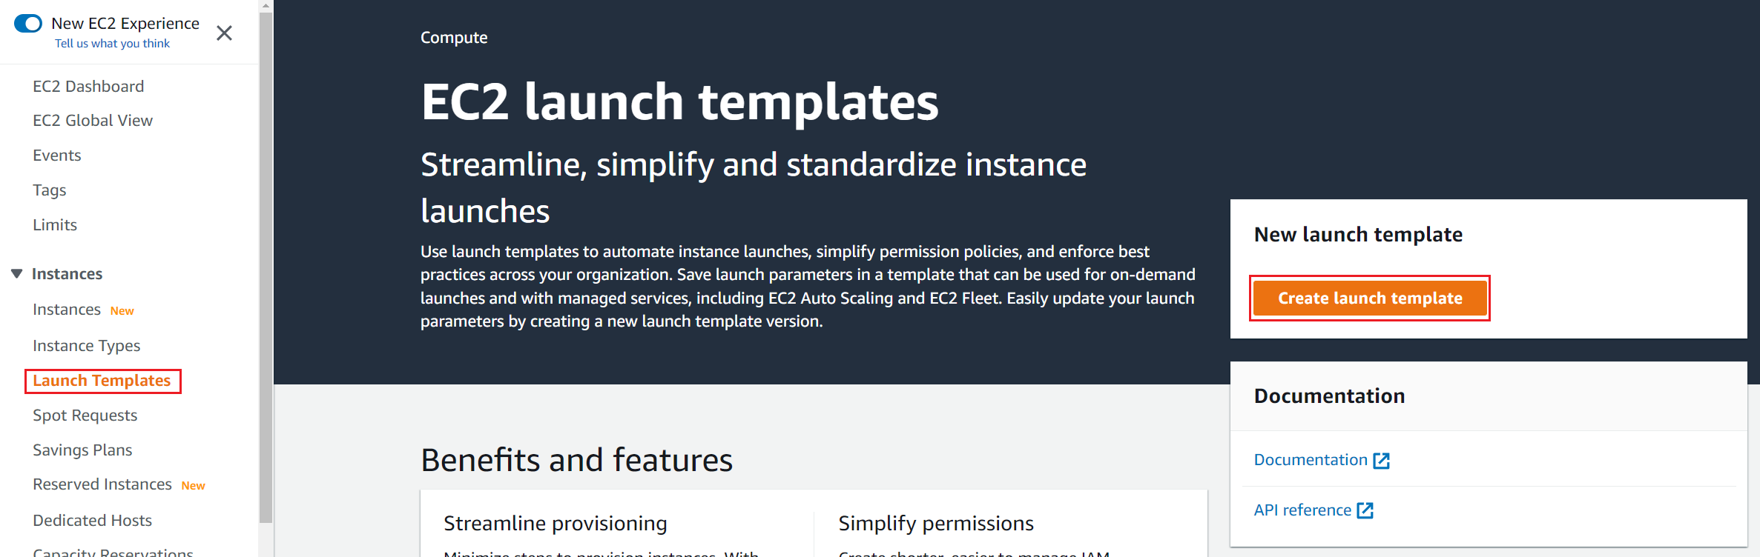
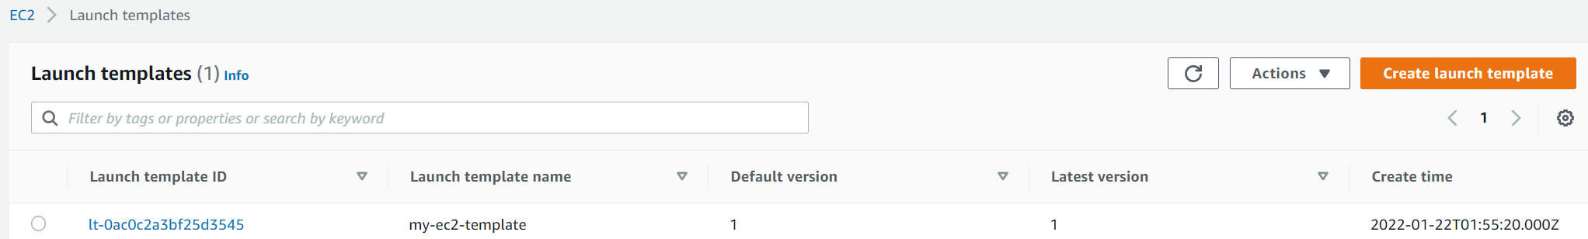
Auto Scaling Group Service
Create Launch Template

Slide 10
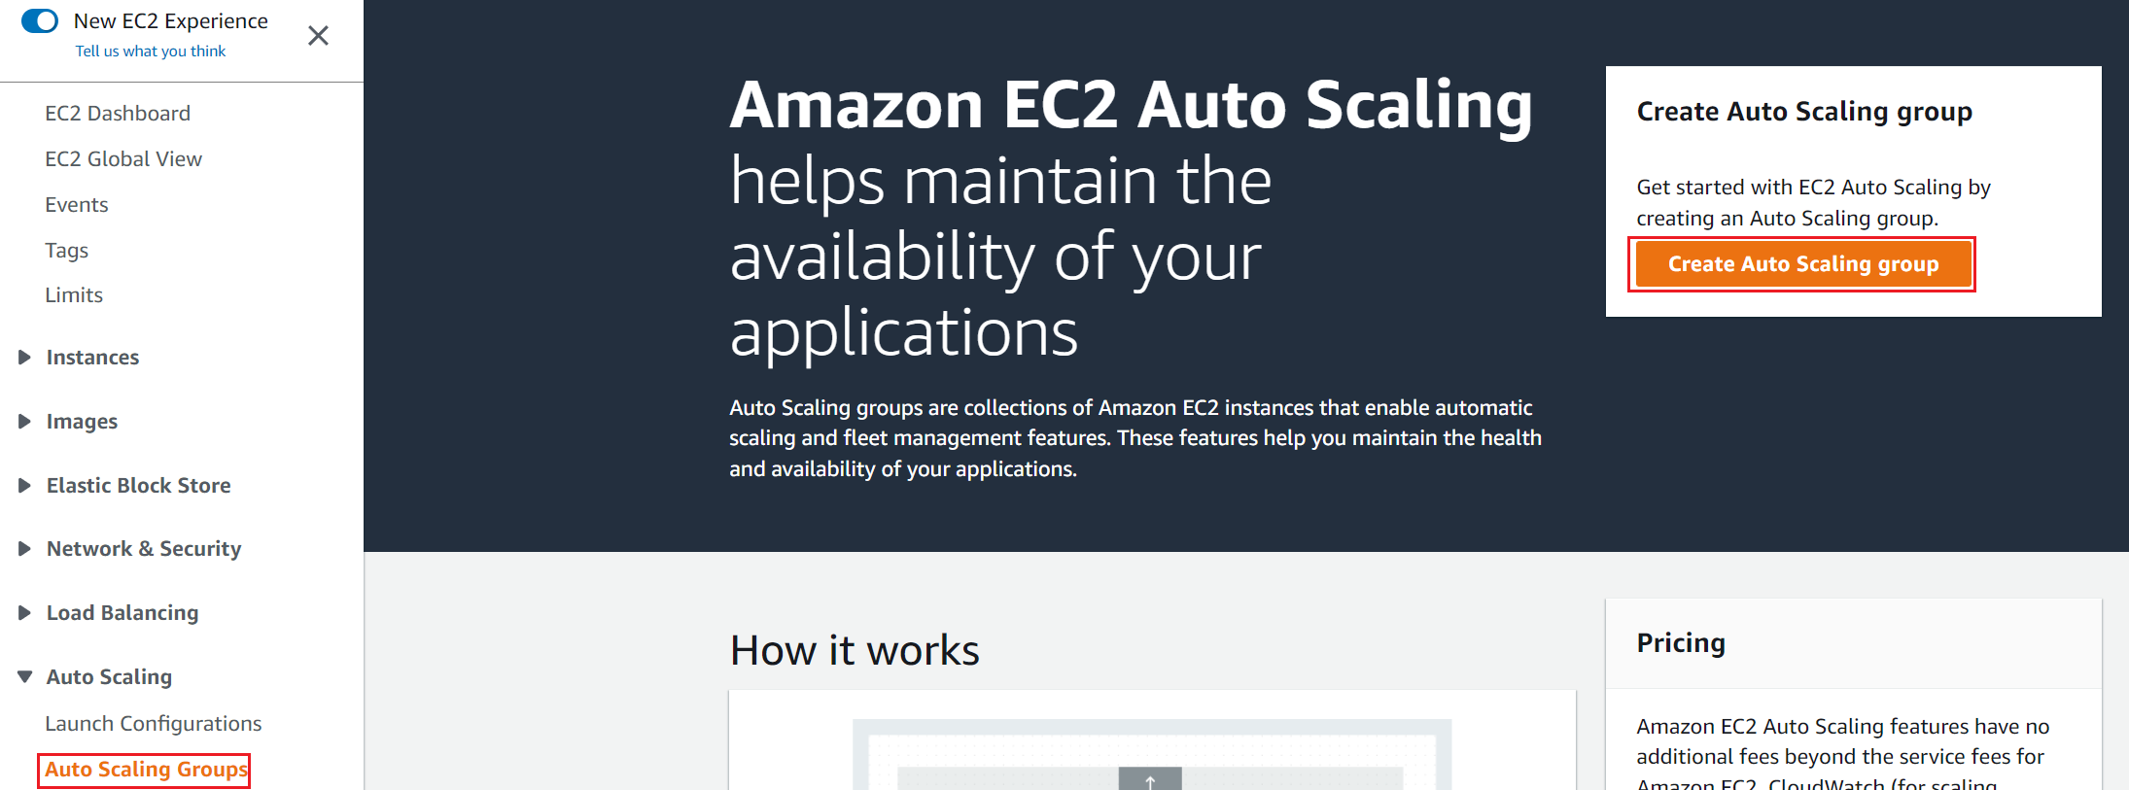
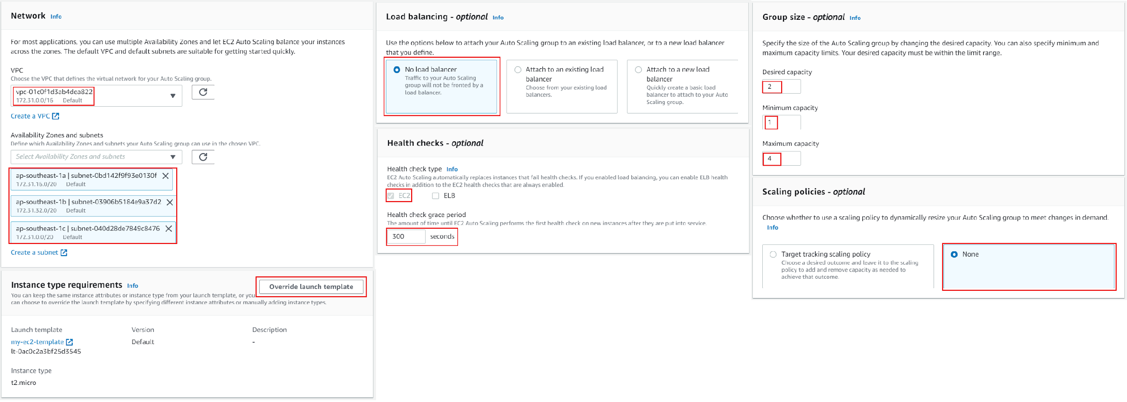
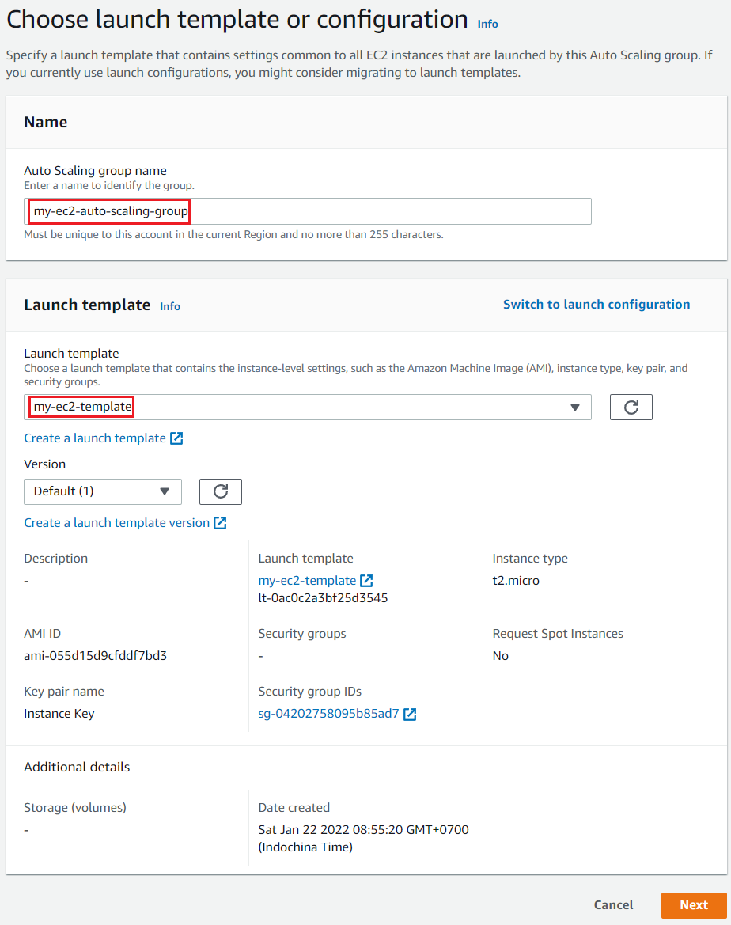
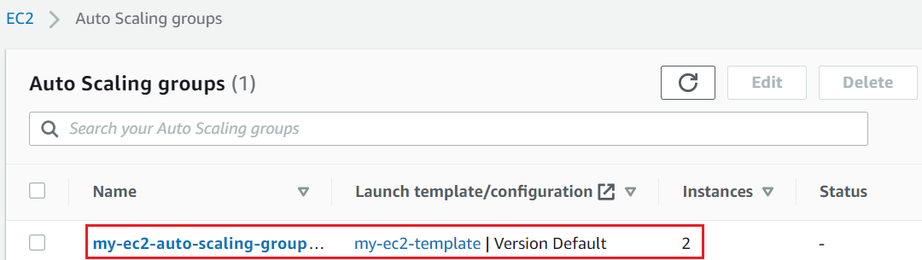
Auto Scaling Group Service
Create Auto Scaling Group

Slide 11
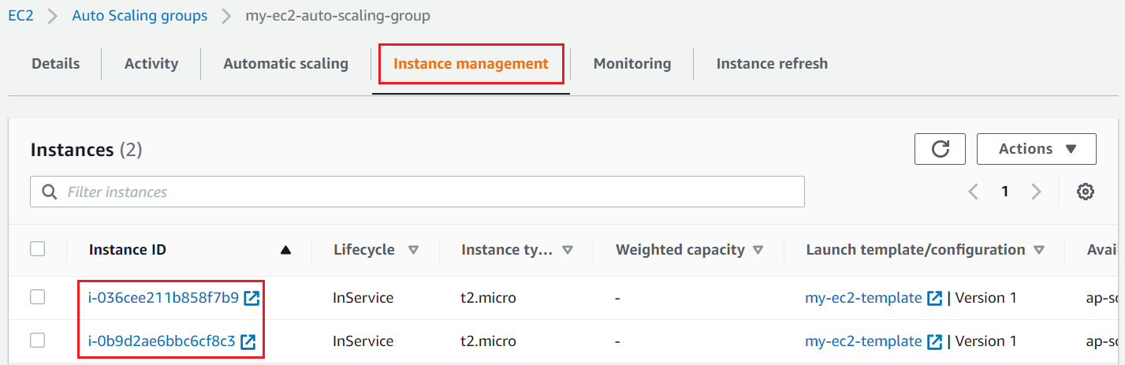
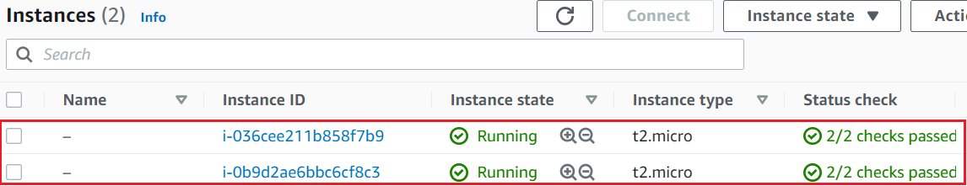
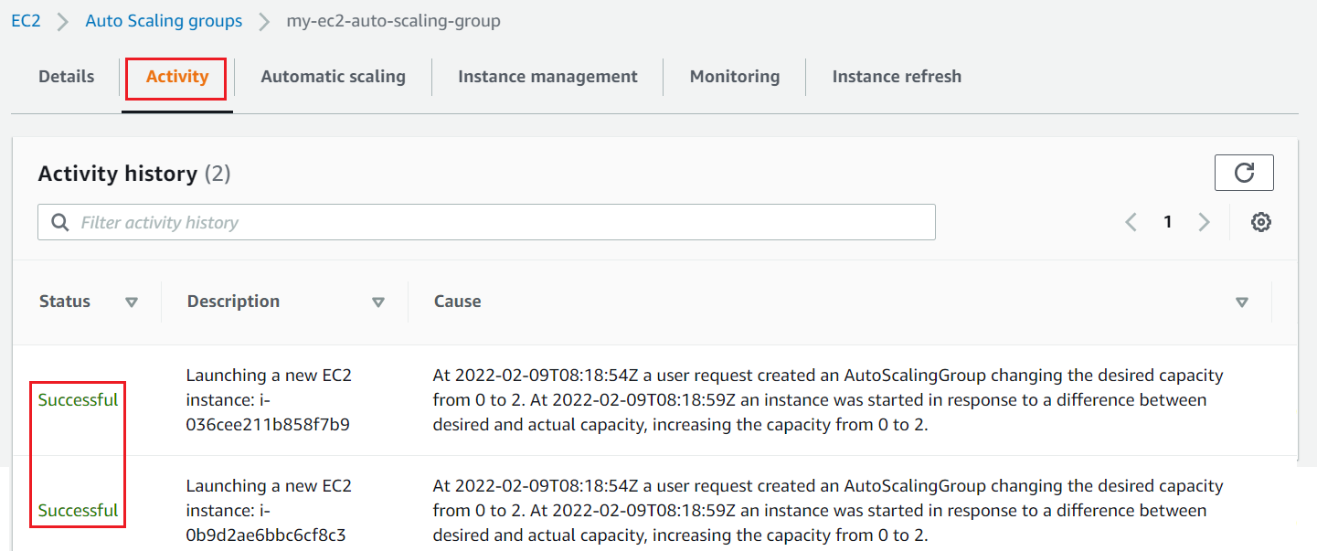
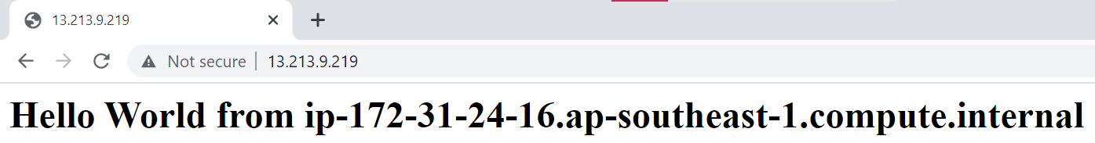
Auto Scaling Group Service

Slide 12
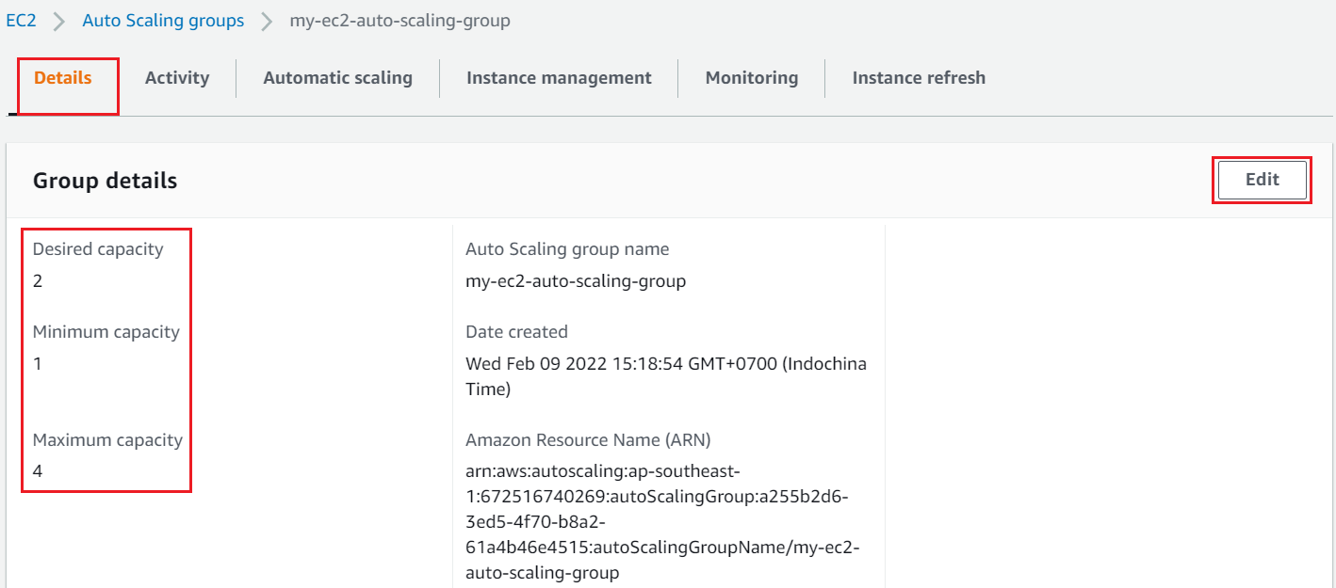
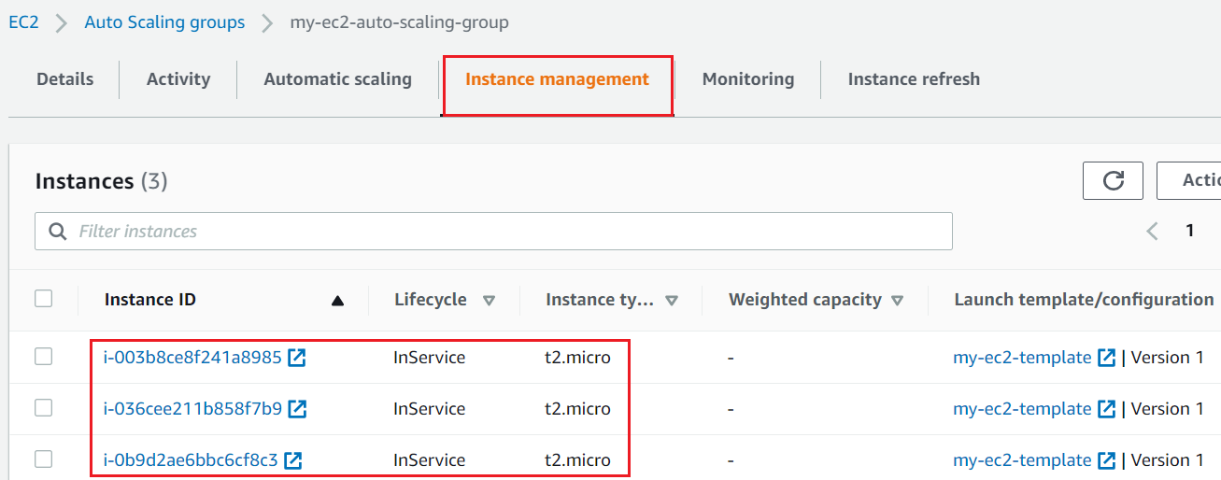
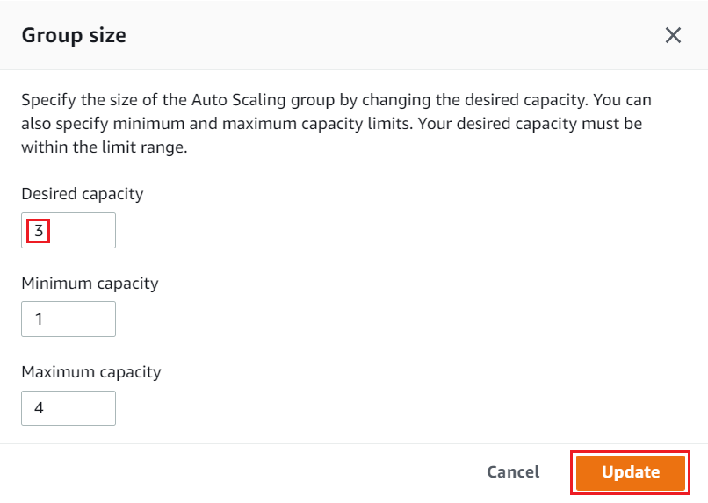
Auto Scaling Group Service
Manual scaling

Slide 13
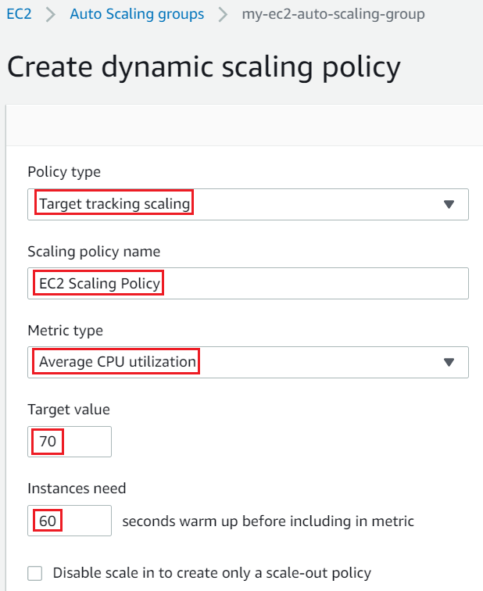
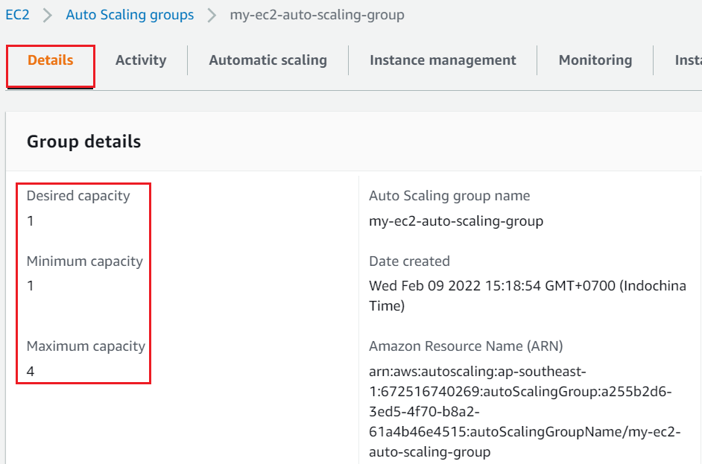
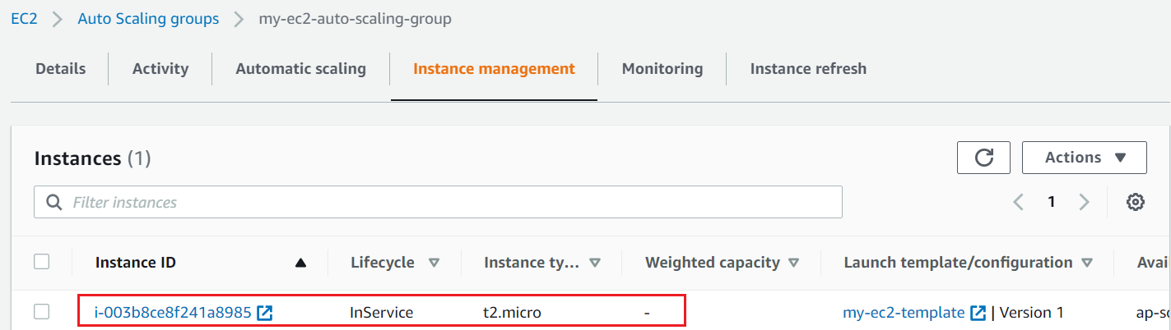
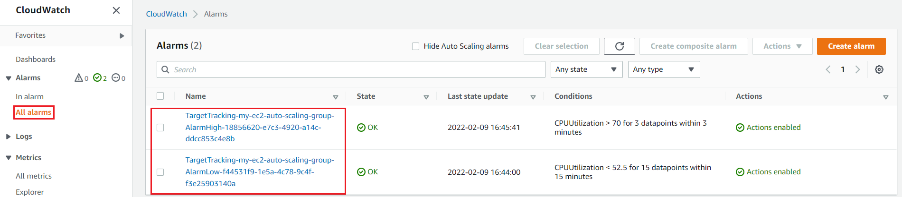
Auto Scaling Group Service
Dynamic scaling

Slide 14
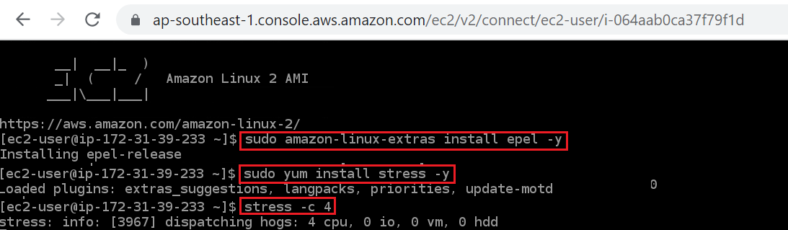
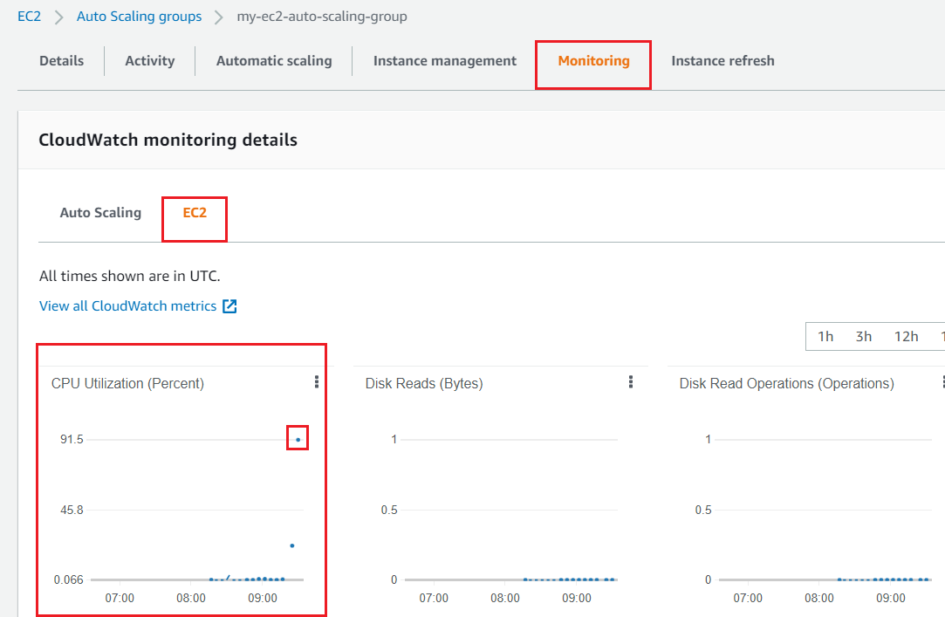
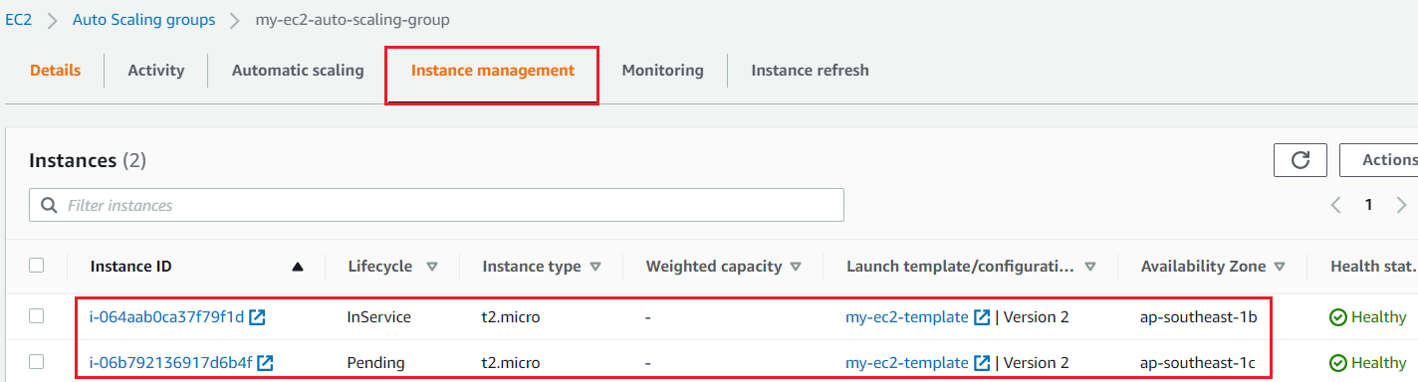
Auto Scaling Group Service
sudo amazon-linux-extras install epel -y
sudo yum install stress -y
stress -c 4
Get full CPU of instance
Result

Slide 15
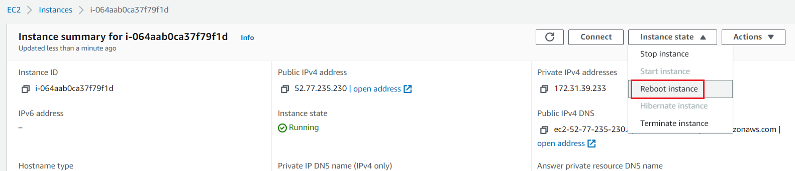
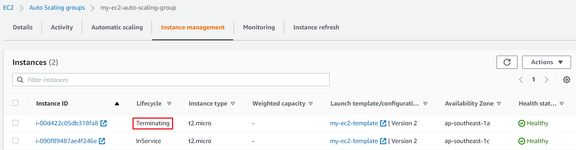
Auto Scaling Group Service
Decrease CPU

Slide 16
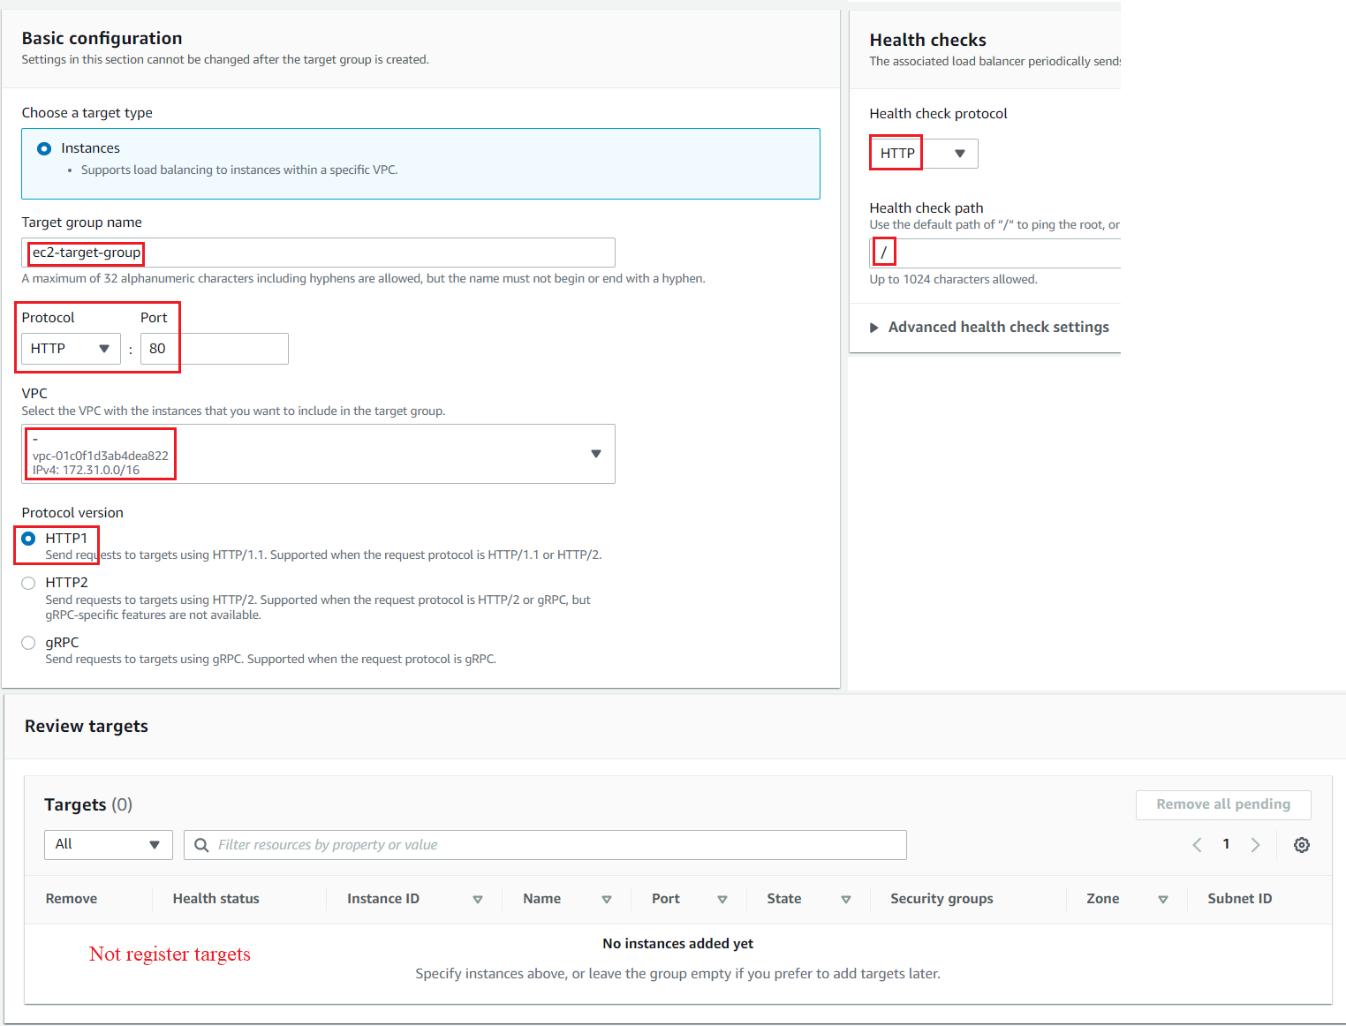
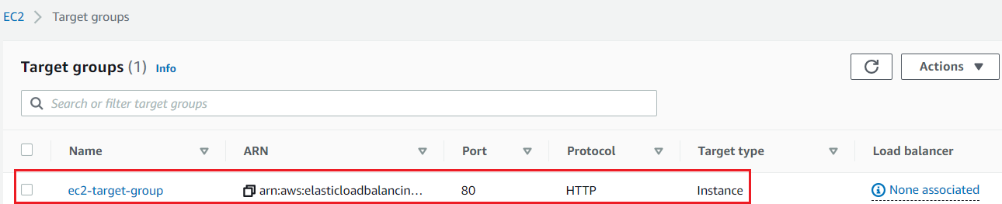
Auto Scaling Group Service
Attach Elastic Load Balancer
Create Target Group

Slide 17
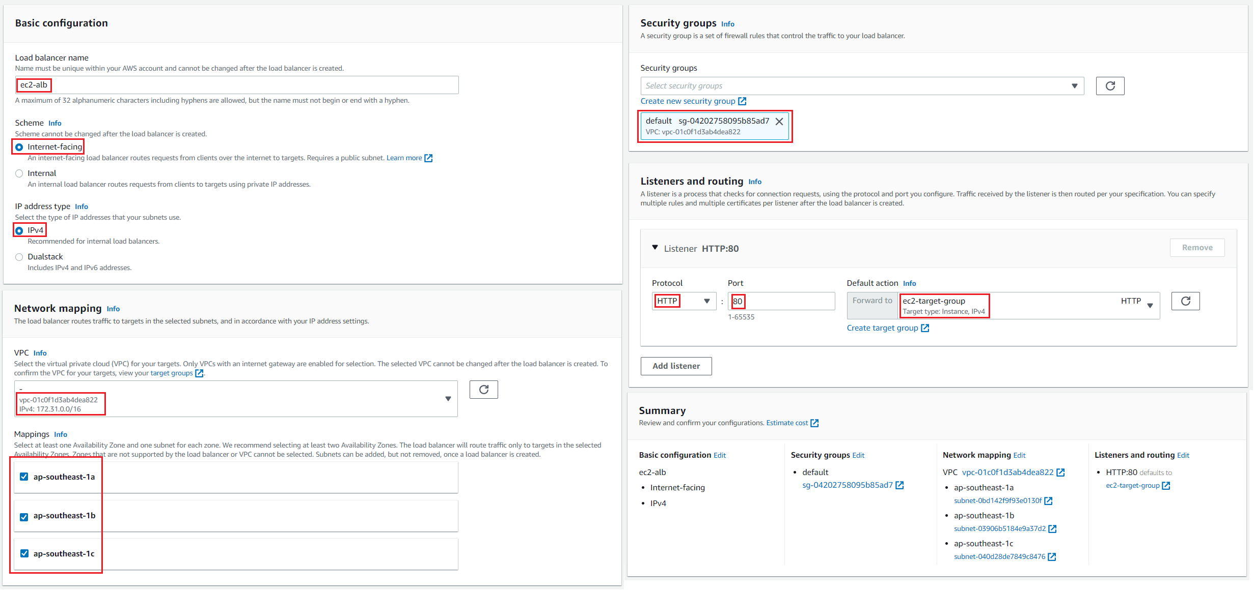
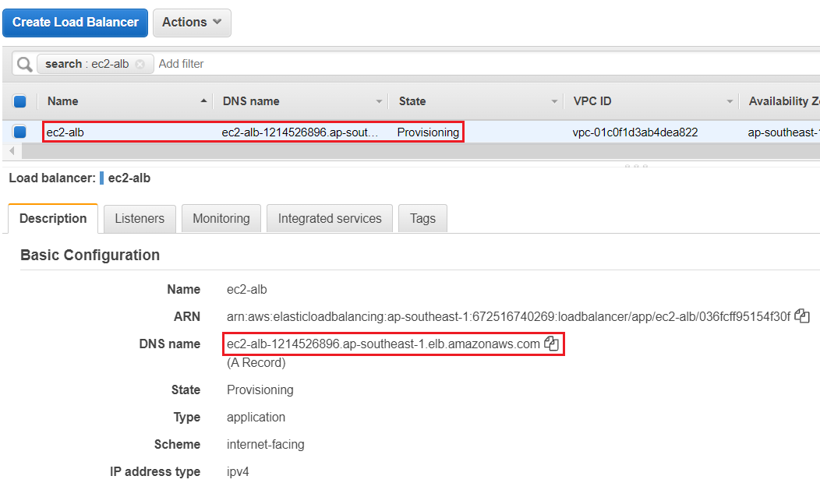
Auto Scaling Group Service
Create ALB

Slide 18
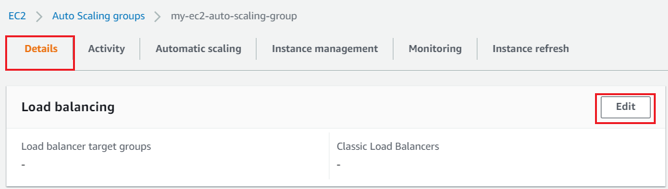
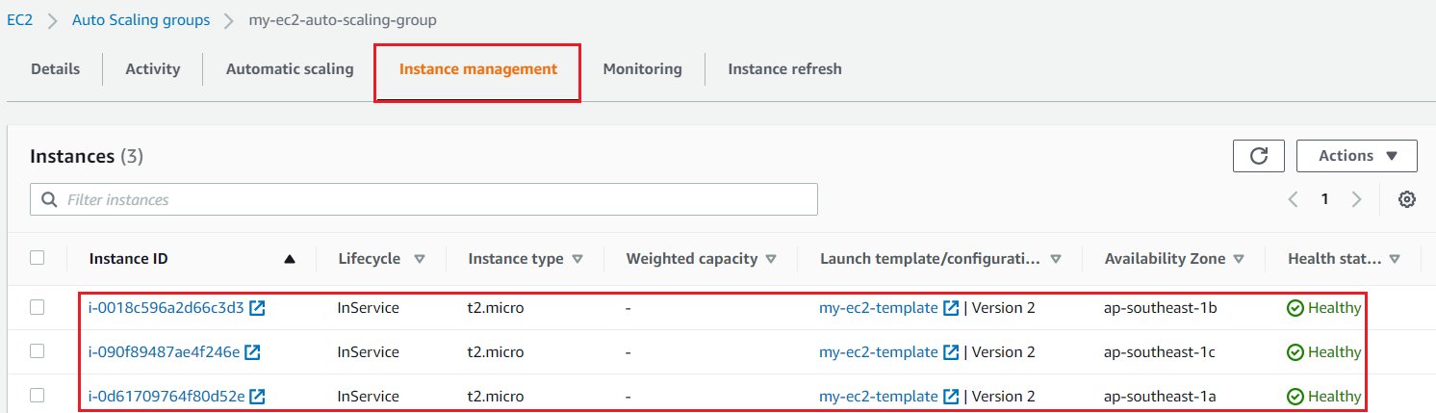
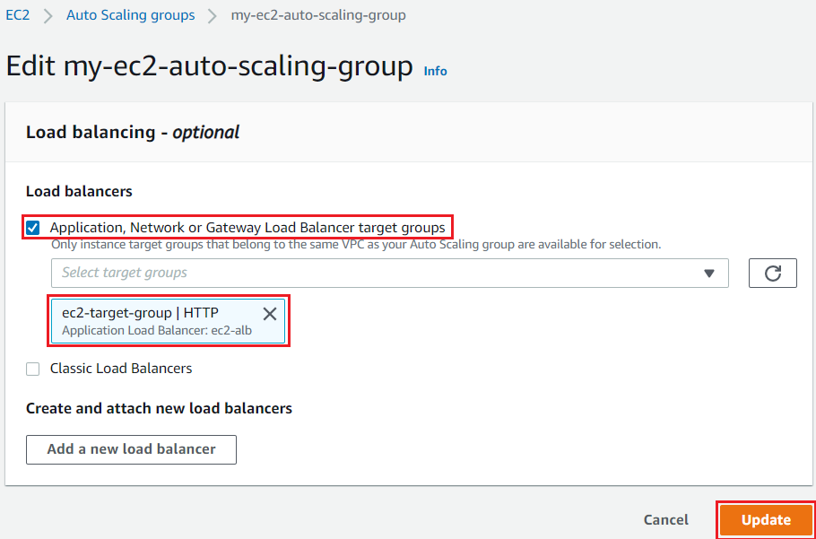
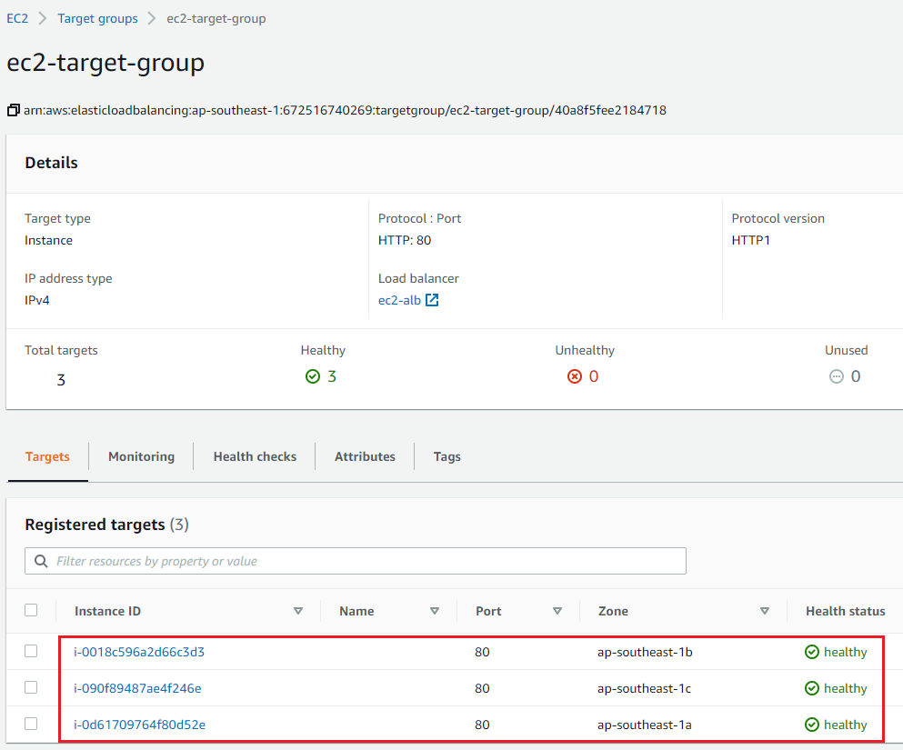
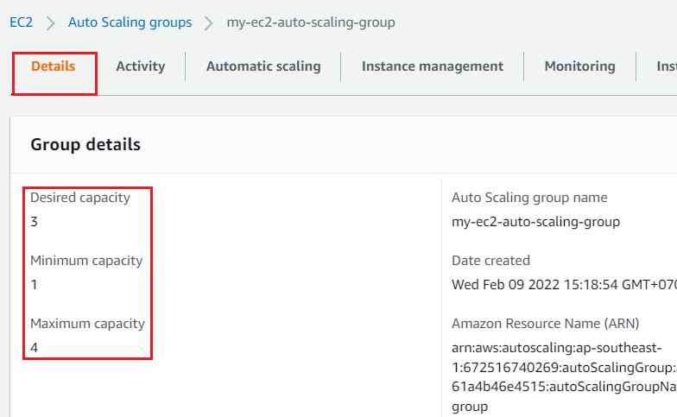
Auto Scaling Group Service
Attach Auto Scaling Group to Target Group of ALB

Slide 19
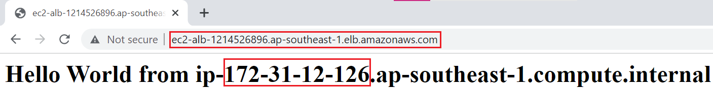
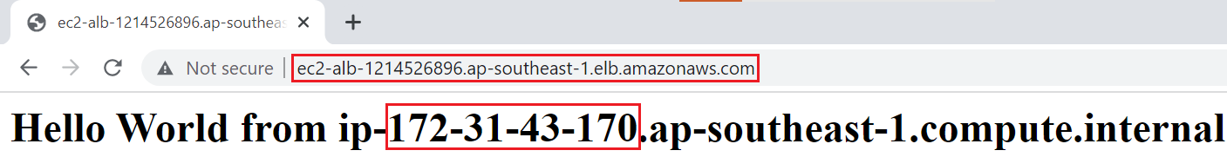
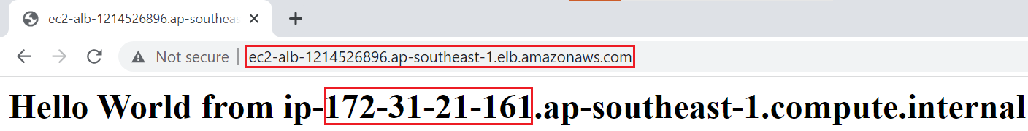
Auto Scaling Group Service
Test ALB

Slide 20
Assignment
Self-practice

Slide 21
Auto Scaling Group Service
Components
Auto Scaling Group
Group size
Configuration template
ELB
Health Check
Scaling policy
Instance lifecycle
SNS (Simple Notification Service)
Activity & Monitoring

Slide 22
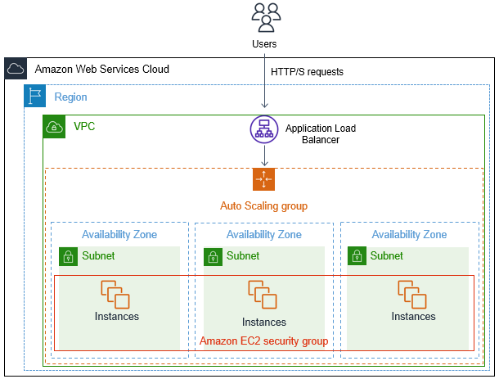
Auto Scaling Group Service
Auto Scaling Group
Contains instances that perform the same function
Ex: group web app, group backend
Use health check & scaling policies to automatically scale instances
Scale out (add EC2 instances) to match an increased load
Scale in (remove EC2 instances) to match a decreased load
Manual / automatic setup

Slide 23
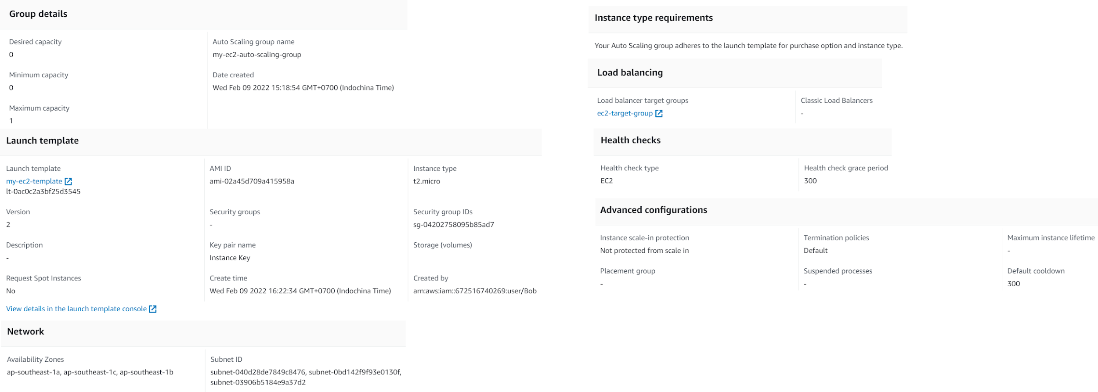
Auto Scaling Group Service
Components

Slide 24
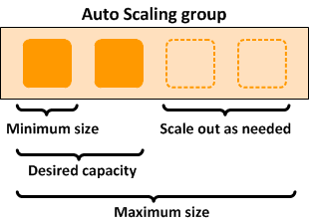
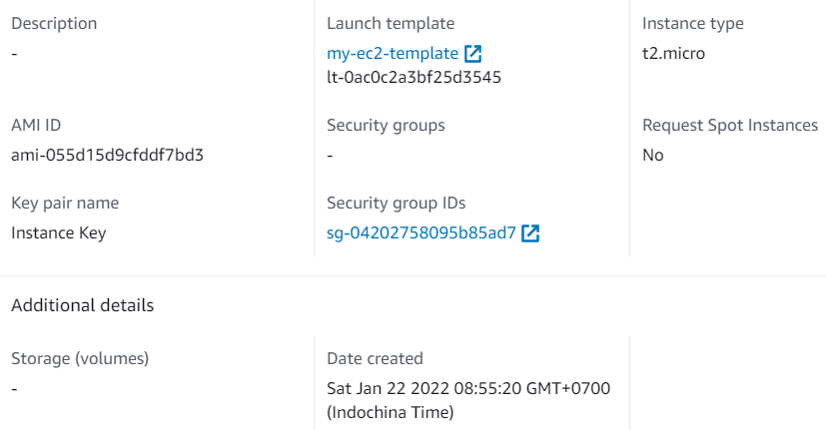
Auto Scaling Group Service
Group size
Configuration template
Define information to launch an instance
Can apply to multiple ASGs
Group size
Launch Template

Slide 25
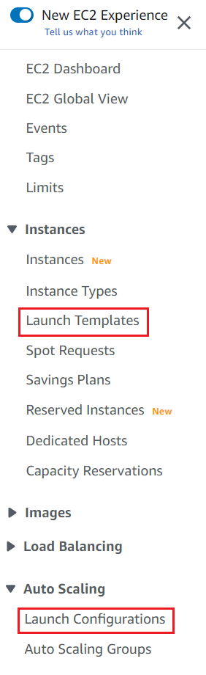
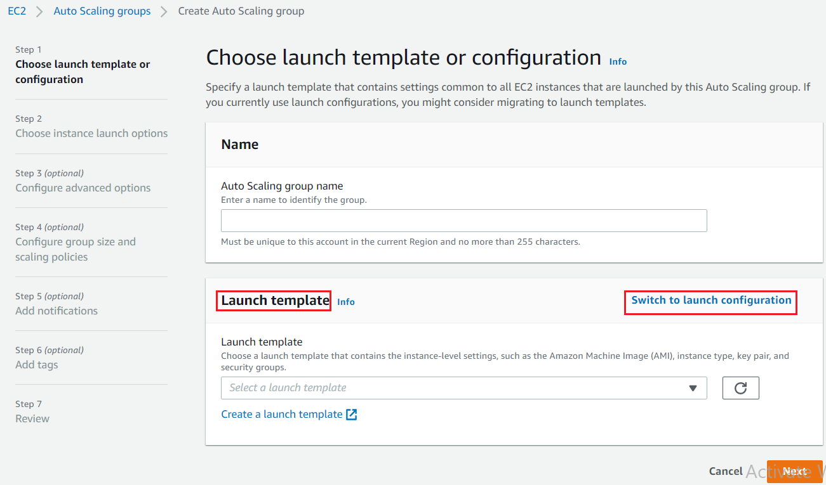
Auto Scaling Group Service
2 types: Launch configuration, Launch template (newer)
Launch Configuration: AMI, Instance Type, EC2 User Data, EBS Volumes, Security groups, Key pair, Version
Launch template: AMI, Instance Type (Optional), EC2 User Data, EBS Volumes, Security groups, Key pair, Network (Optional), Version

Slide 26
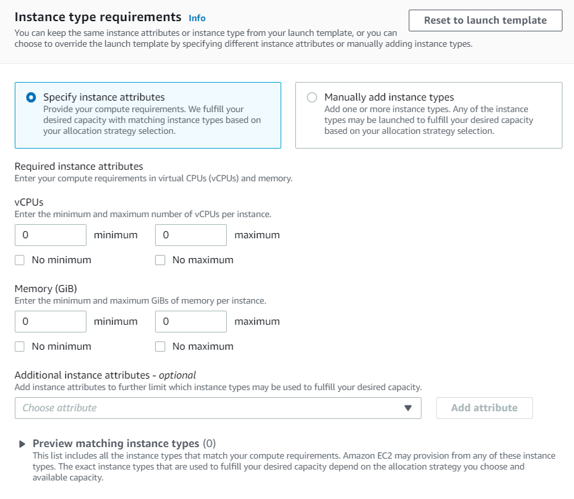
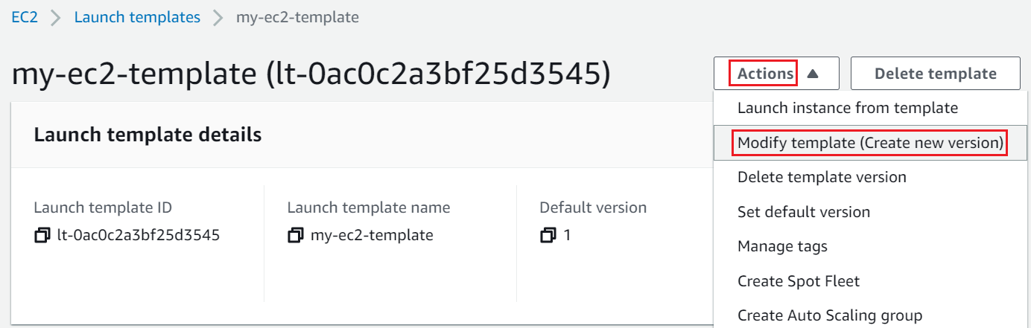
Auto Scaling Group Service
Cannot be modified after creation 🡺 create new version
ASG can override instance type of Configuration template

Slide 27
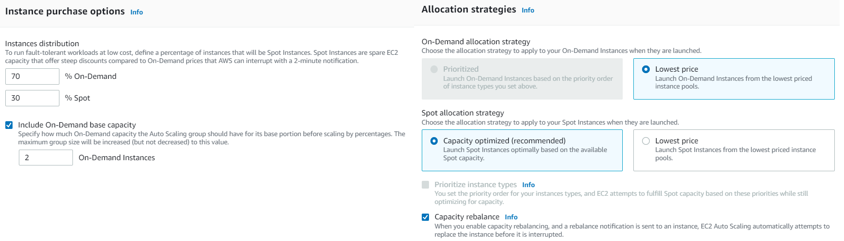
Auto Scaling Group Service
Instance purchase options
2 options:
Adhere to launch template: Launch on-demand & spot instance according to the Configuration template
Combine purchase options and instance types: Launch a fleet of on-demand and spot instances with different instance types

Slide 28

Auto Scaling Group Service
ELB
Health check: Including Auto scaling group health check (always enable) & ELB health check
ELB
Health Check

Slide 29

Auto Scaling Group Service
Scaling policy
Maintain current instance levels at all times
4 types:
Manual scaling
It is possible to manually change the config at any time
Maintaining a fixed number of instances
(set Desired capacity = Minimum capacity = Maximum capacity)

Slide 30

Auto Scaling Group Service
Dynamic scaling
Based on demand (capacity)
Combine with CloudWatch Alarm to detect threshold

Slide 31


Auto Scaling Group Service
3 types:
Target tracking scaling: based on CPU, Network, request count
Simple scaling: Support single scaling adjustment
Step scaling: Support list of scaling adjustments
We can auto scale based on a custom metric (ex: number of connected users)
Step 1: Send custom metric from application on EC2 to CloudWatch (PutMetric API)
Step 2: Create CloudWatch alarm to react to low/high values
Step 3. Use the CloudWatch alarm as the scaling policy for ASG
Tutorial: https://www.youtube.com/watch?v=WtgcMIkoaic

Slide 32


Auto Scaling Group Service
Predictive scaling
AWS develops AI that automatically detects how to scaling (based on data on cloudwatch)
Tutorial: Link
Scheduled scaling
Based on schedule
Usecase: you know your visitors patterns
Tutorial: Link
Predictive scaling
Scheduled scaling

Slide 33


Auto Scaling Group Service
Cooldown
Is time for the instance to start up (the software setup is done), Reduce the cooldown period 🡺 serving request fasters
If cooldown value = 0, CloudWatch metric has reached the threshold, then CloudWatch Alarm will trigger to start multiple new instances at the same time
During the cooldown period, the ASG will not launch or terminate additional instances

Slide 34


Auto Scaling Group Service
Termination policies
Default Termination Policy
Find the AZ which has the most number of instances
If there are multiple instances in the AZ to choose from, delete the one with the oldest launch configuration
ASG tries the balance the number of instances across AZ
Default Termination Policy

Slide 35

Auto Scaling Group Service
Instance lifecycle
Lifecycle Hooks
You have the ability to perform extra steps before the instance goes in service (Pending state)
You have the ability to perform some actions before the instance is terminated (Terminating state)
Tutorial: Link
https://docs.aws.amazon.com/autoscaling/ec2/userguide/AutoScalingGroupLifecycle.html

Slide 36


Auto Scaling Group Service
Warm pool (warm start)
Pre-initialized EC2 instances, Using for long-initialized instances
SNS
Send notification when instance launch, terminate, ...
Config warm pool: Link

Slide 37


Auto Scaling Group Service
Activity
Monitoring
Activity
Monitoring

Slide 38
Assignment
Self-practice

Slide 39
Summary
Scalability means that an application / system can handle greater loads
Vertical Scalability: Increase/decrease instance size = scale up/down
Horizontal Scalability: Increase/decrease number of instances (= scale out/in)
ASG make sure the available EC2 is working, contains instances that perform the same function
Automatically turn on/off the instance when overloaded
Free, pay for the underlying resources being launched
Using both spot instance + on-demand instance for reducing cost
Usecases: unstable application, Web Application, Distributed Application

Slide 40
Summary
Components
Group size: desired capacity, minimum capacity, maximum capacity
Configuration template: Launch configuration/Launch template (newer), Cannot modify
Health Check: Auto scaling group health check (always enable) & ELB health check
Scaling policy: Manual scaling, Dynamic scaling, Predictive scaling, Scheduled scaling, other (Cooldown, Termination policies)
Instance lifecycle: Lifecycle Hooks, Warm pool
SNS, Activity & Monitoring
Integrated services: ELB, CloudWatch

Slide 41
Assignment

Slide 42
Quiz

Slide 43
Reference
https://docs.aws.amazon.com/

Slide 44
Q & A
Copyright © VTI Academy All Rights Reserved

